Slide 1
Decentralized ML: Federated Learning for Privacy Preservation
Lung-cancer prediction across three simulated hospitals
Flower · Opacus (DP-SGD) · Secure aggregation · Membership inference

Slide 2
Problem
• Centralizing patient records concentrates privacy risk (breach, misuse, regulation)
• Federated learning: train together, keep rows local, share only model updates
• Updates still leak, so we add DP and secure aggregation and measure the cost and the protection

Slide 3
Why federated?
• Each hospital trains locally; the server averages weights: w = Σ (n_k / N) · w_k
• Raw rows never leave a hospital; only HospitalClient code opens a hospital file
• The server evaluates on a shared test file only
• FedAvg verified against a 40-line reference (difference 6e-8)

Slide 4
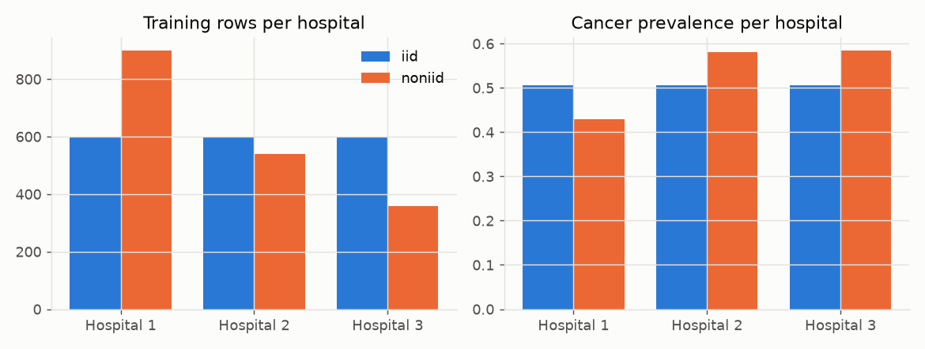
Dataset and privacy preprocessing
• Kaggle lung cancer: 3,000 rows, 15 features, 2 duplicates removed
• No identifiers; age → 10-year bands for the report, model uses age/100 (fixed constant)
• k-anonymity: pooled 25; per hospital 1–8 (non-IID hospital 3 has k = 1)
• Finding: label ≈ unlearnable (CV AUC 0.501 logistic, 0.523 forest): all models near chance

Slide 5
Architecture and hospitals
• 60 / 10 / 20 / 10 split: train / val / test / attack hold-out
• Non-IID: 900 / 539 / 359 rows, prevalence 43% / 58% / 58%
• MLP 15→32→16→1 (1,057 params); 20 rounds × 2 local epochs; centralized gets a matched 40 epochs
• Flower FedAvg + NumPyClient, 5 seeds, one shared test file

Slide 6
Methods
• DP-SGD: clip C = 1, noise σ·C, δ = 1e-5, persistent accountant across rounds
• Secure aggregation: pairwise masks, integer arithmetic mod 2^32, exact cancellation (simulation)
• Membership inference: loss threshold, balanced sets, positive and negative controls
• Extras: FedProx, 8/4-bit update quantisation, label-flip poisoning with median defence

Slide 7
Live system: Hugging Face + Render + hospital clients
• Primary global model v0 (FedAvg over 3 simulated hospitals) published on Hugging Face (Adhi-gg029/lung-cancer-federated-learning)
• Render server = coordinator: login, download model, upload weights, FedAvg into v(k+1), publish; also serves the dashboard
• Hospital client: downloads the model, trains on its own CSV (never uploaded), optional local DP, uploads weights + row count
• Hospitals and sub-hospitals register themselves; hashed passwords, login throttle, stale-update 409, shape/NaN checks, update-size guard, optional median aggregation
• Dashboard: security of every round, raw data never leaves, DP status, attacks and risk score, ordinary-vs-protected demo, EDA
• Train & Contribute: upload a CSV batch, train in the browser (optional DP), watch the round animate through to the Hugging Face update
• Verified: 99 tests, a real-browser end-to-end round with two hospitals, and a black-box smoke test of the deployment

Slide 8
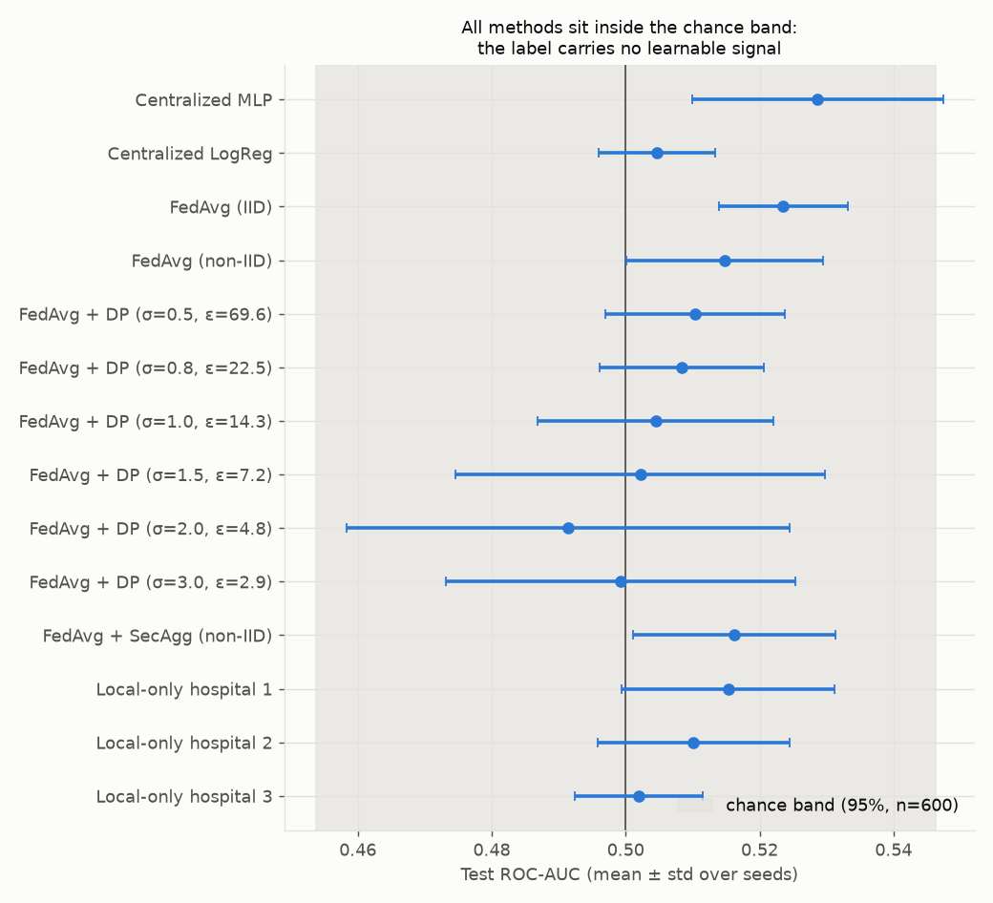
Accuracy: no difference, because the data has no signal
• Centralized MLP AUC 0.529
• FedAvg IID 0.524 · non-IID 0.515
• FedAvg + SecAgg 0.516
• All inside the 95% chance band 0.5 ± 0.046
• Planted-signal check: centralized 0.78, FedAvg 0.79–0.81, FedAvg + DP 0.80

Slide 9
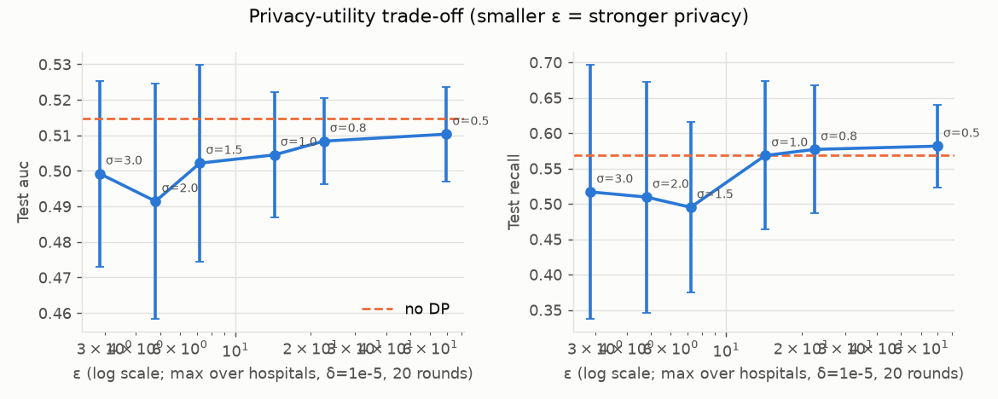
Privacy-utility curve
• ε from 69.6 (σ = 0.5) down to 2.9 (σ = 3.0), δ = 1e-5, 20 rounds
• No visible utility drop: there is no signal to lose
• Smaller hospitals get a larger ε at the same σ

Slide 10
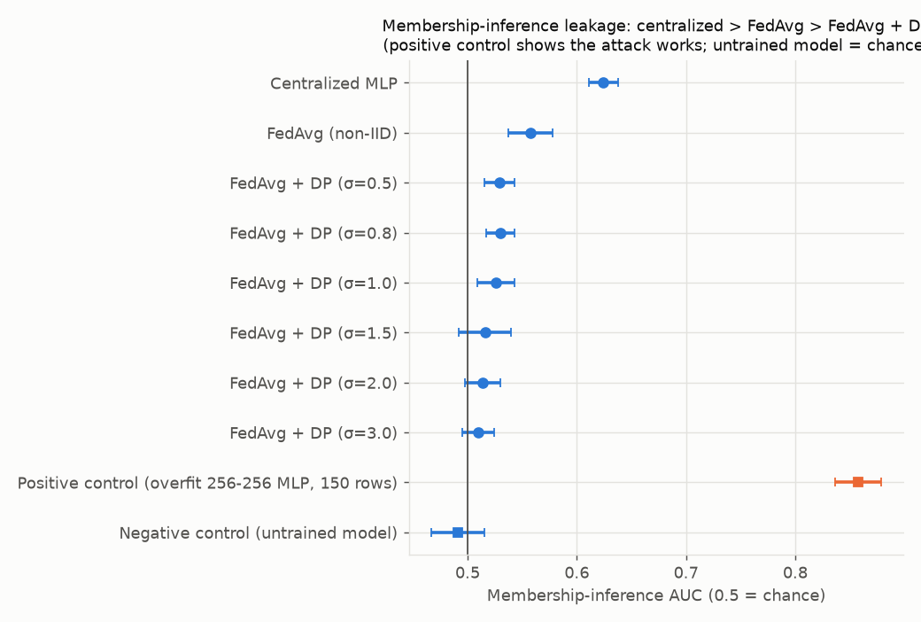
Attack results: leakage falls
• Centralized 0.624 → FedAvg 0.558 → DP σ=3.0 0.510
• Positive control 0.858 (attack works)
• Untrained model 0.491 (chance)
• One simple attack; low AUC is not proof of privacy

Slide 11
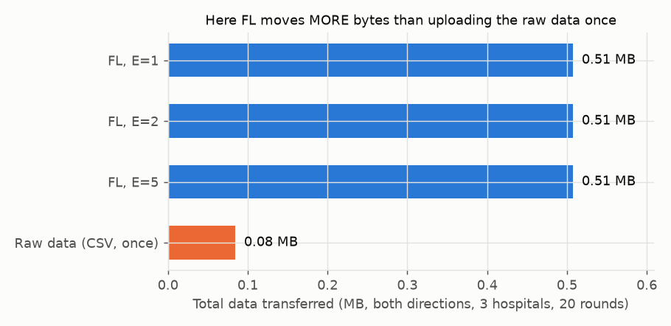
Secure aggregation and communication
• Masked integer sum = plain sum (difference 0); a masked update is uncorrelated with the truth
• Dropout: masks do not cancel (error ≈ 2,048) → round aborted; real protocols use secret sharing
• FL: 8.5 KB / hospital / round, 0.51 MB total vs 0.084 MB to upload the raw data once (~6× more)

Slide 12
Extras: quantisation, FedProx, poisoning
• 8-bit updates: 26% of the upload bytes; planted-signal AUC 0.795 vs 0.794
• FedProx: no measurable change on the real data (everything is at chance); see report 6.8
• Label-flip hospital 1 (planted-signal data): FedAvg 0.598, median 0.799 (clean 0.794)
• Poisoning on real labels is unmeasurable: there is no signal to corrupt

Slide 13
Limitations
• Near-random survey data; no clinical claim
• Simulated (not cryptographic) secure aggregation
• One simple attack; in-process Flower; 3 hospitals, ~1.8k rows
• Next: real data, real key agreement, shadow-model attacks, robust aggregation

Slide 14
Conclusion and demo
• Verified end-to-end FL pipeline: correct DP accounting, exact secure aggregation
• Federating and adding DP progressively reduce membership-inference leakage (0.624 → 0.558 → ~0.51)
• Accuracy cannot separate methods on this dataset
• Demo: dashboard → hospitals → comparison → ε curve → secure-aggregation dropout → one prediction

